Slide 1
Covid-19 Outliers & Statistics
Sana Khan

Slide 2
Core Message
Have hospitalizations risen due to COVID-19 cases among patients? Has the death rate increased? Are pre-existing conditions a factor in positive diagnoses?

Slide 3
Questions Analyzed
What are the hospitalization rates of COVID-19 patients?
How many COVID-19 deaths have been confirmed?
What are the statistics of confirmed COVID-19 cases, deaths and percentage of cases based on population data?
Are patients with medical conditions more susceptible to COVID-19?
My objective was to analyze datasets that look at COVID-19 statistics by state and country (confirmed versus deaths), medical conditions that may contribute, and data of COVID-19 associated hospitalization rates.
Brief Summary

Slide 4
Data Sources
Coronavirus Numbers By State: This dataset assisted with retrieving hospitalization rates based on states in the U.S.
COVID-19_Worldwide: This dataset assisted with analyzing confirmed cases vs. deaths among countries and territories outside of the U.S.
covid_19_clean_complete: This dataset assisted with retrieving hospitalization rates outside of the U.S.
Medical_Conditions: This dataset assisted with retrieving the types of medical conditions among children and adults identified positive for COVID-19.
I used the following to obtain these datasets:
Kaggle
CDC.gov

Slide 5

Data Exploration/Cleanup

Slide 6

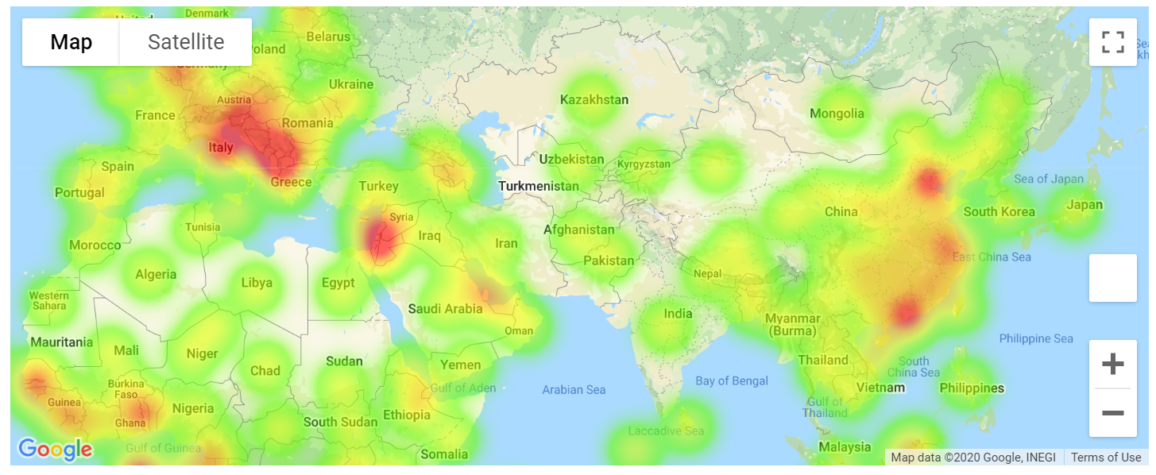

Slide 7

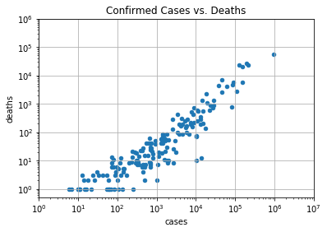

Slide 8
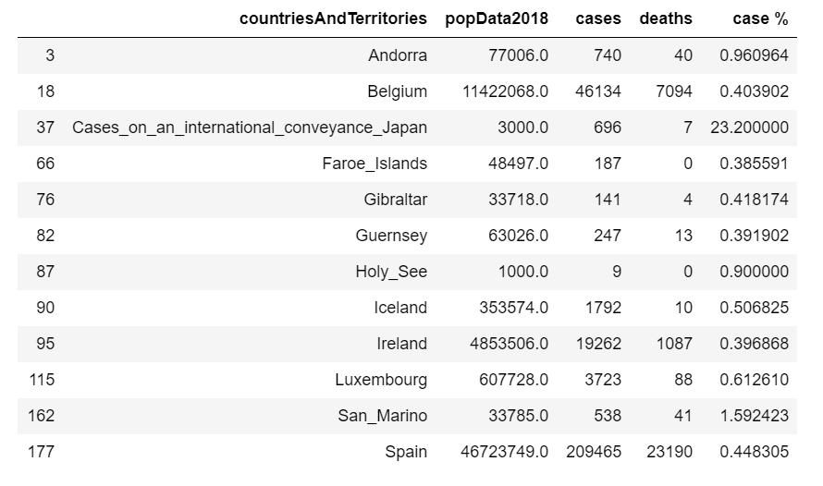


Slide 9
Data Analysis

Slide 10
What are the hospitalization rates of COVID-19 patients?

Slide 11
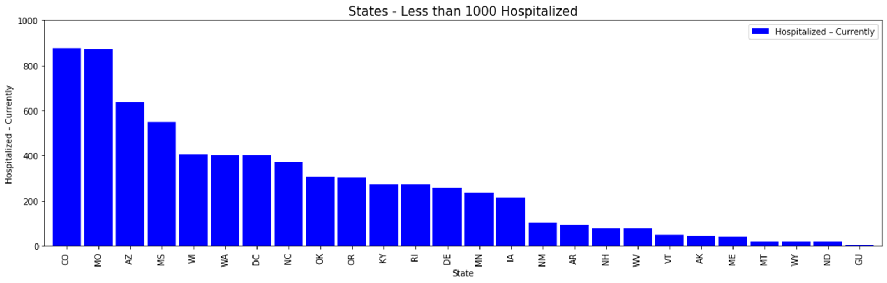
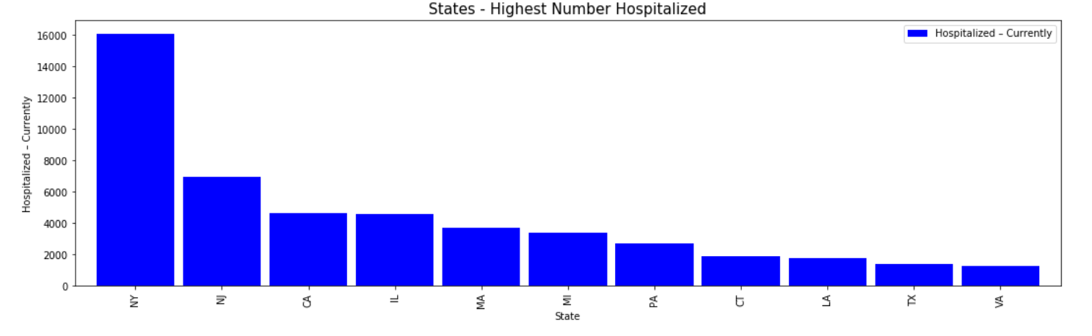

Slide 12
Summary Findings:
New York had the highest current hospitalization rate, while Colorado had the lowest current hospitalization rate. New York being an outlier prompted me to create a set of conditions (described above) to plot a select number of cities to compare from. New York had up to 16,000 hospitalizations, while Colorado had between 800 to 900.

Slide 14
Summary Findings:
Based on the map above, Italy had a max intensity heat marker. This showed that Italy was the most affected during the outbreak of this pandemic, in comparison to the other countries on the map.

Slide 15
How many COVID-19 deaths have been confirmed?

Slide 16
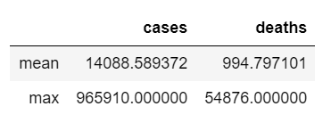
Summary Findings:
The logarithmic function plotting cases vs. deaths suggested a positive correlation between x and y. Death counts rose as the number of confirmed cases increased. Given that this is calculating the sum of cases vs. deaths, the findings of a positive correlation support the data.

Slide 17
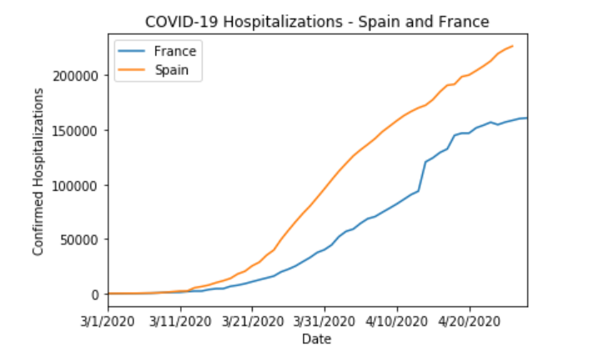

Slide 18
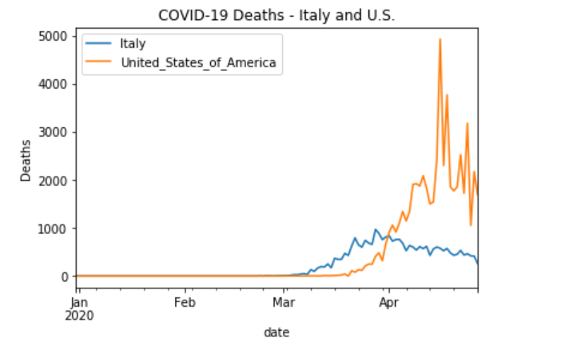

Slide 19
Summary Findings:
The death rate in the U.S. and Italy does not peak until March. From January to March, the death rate remained at 0. Again, we see that the average number of deaths was significantly higher compared to the average number of cases. The max value of cases was also higher than the max value of deaths. This further confirms that the number of cases have no correlation with the number of deaths.

Slide 20
What are the statistics of confirmed COVID-19 cases AND Deaths?

Slide 21
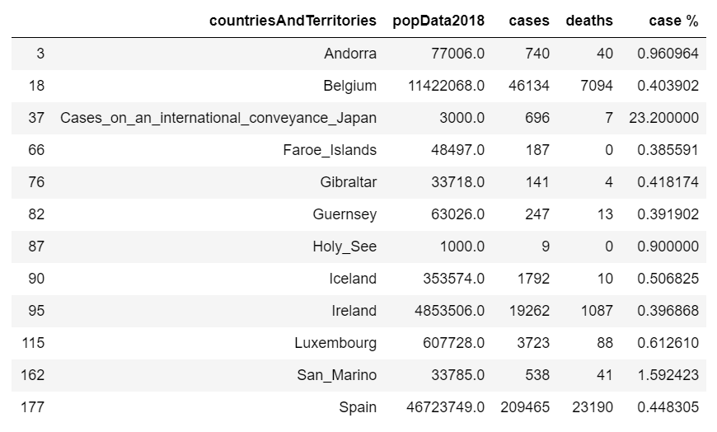
Summary Findings:
Most countries and territories, when compared against population data, had less than 1% of cases. This could be viewed as an analomy as the dataset calculated deviated significantly and did not show an even pattern, compared to the previous analyses above.

Slide 22
Are patients with medical conditions more susceptible to COVID-19?

Slide 23
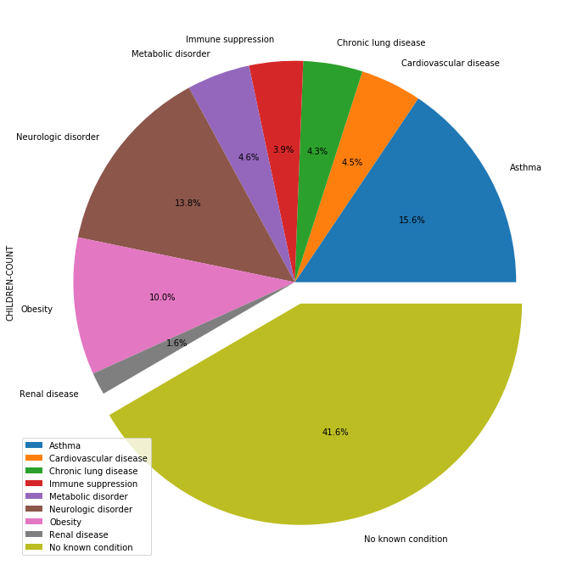

Slide 24
Summary Findings:
41.6% of children that contracted the virus had no known conditions. This also prompts me to believe that the dataset was derived from a very small sample, as compared to the analysis in previous sections. The percentages do not represent a large dataset. This could also be considered a limitation, as we cannot accurately determine correlation between contracting the virus among patients with known conditions based on the sample size.
Diagnosed children with asthma had a higher percentage than children with other medical outliers and diagnosed children with renal disease had a lower percentage rate.

Slide 25
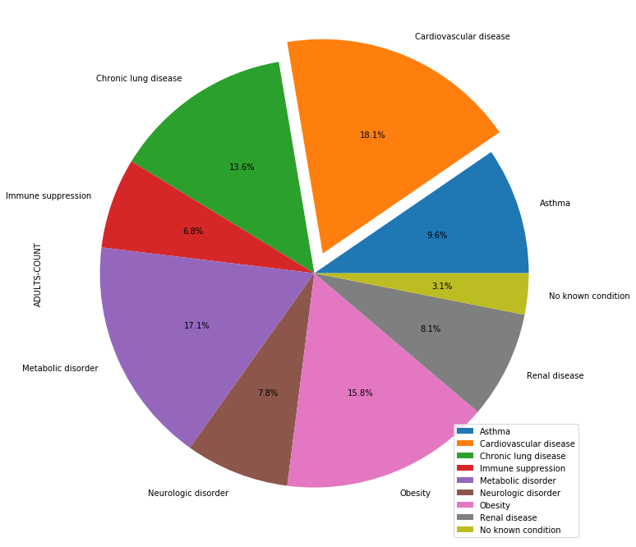

Slide 26
Summary Findings:
Diagnosed adults with cardiovascular disease had a higher percentage than adults with other medical outliers and diagnosed adults with immune suppression had a lower percentage rate. The percentage of adults with no known conditions was significantly lower than the percentage of children with no known conditions. Again, this could be presented as a limitation due to the size of the sample population represented.

Slide 27
Discussion
The U.S. had the greatest number of deaths compared to Italy, France, and Spain, while hospitalization rates for France and Spain peaked. France had 150,000 hospitalizations, whereas Spain had a little over 200,000 hospitalizations. The increase in these death rates could be due to population size based on country, meanwhile the growing rate in cases did not result in deaths (high-to-low).
'Cases_on_an_international_conveyance_Japan' could be seen as an outlier, as the percentage rate (23.2%) in cases was significantly higher compared to other countries and territories. This specific row leads me to believe that this may have been, for example, a cruise ship given the population size of 3000.
Based on the dataset for medical conditions among adults and children, the chances of contracting the virus do not show any correlation with pre-existing medical conditions. Children with neurological disorders (13.8%) were, however, more susceptible to contracting the virus than adults (7.8%). Whereas, adults with obesity (15.8%) had a higher chance of contracting the virus than children with obesity (10%).

Slide 28
Limitations

Slide 29

Questions?

